Slide 1

ZOMATO RESTAURANTS ANALYSIS
VASU BHATLA
18/07/2025

Slide 2
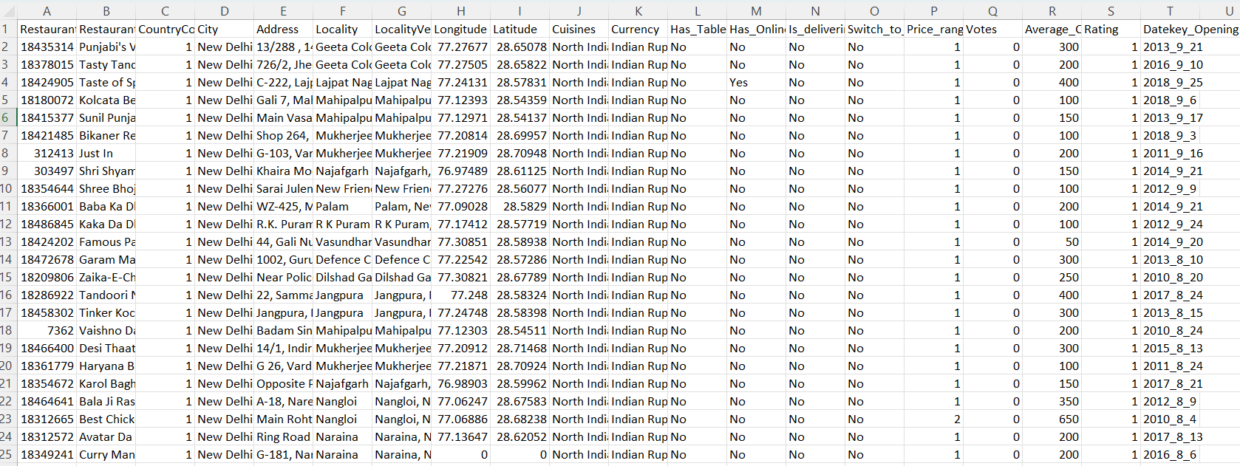
PROBLEM STATEMENT
You are hired as a consultant data analyst by Zomato where the team is looking for expansion and opening restaurants. Your task is to come up with strategies/suggestions about opening newer restaurants.

Slide 3
DATA OVERVIEW
Restaurant ID: Unique identifier for each restaurant.
Restaurant Name: The name of the restaurant.
CountryCode: Country code of the location where the restaurant is situated.
City: The city where the restaurant is located.
Cuisines: The type of cuisine offered by the restaurant.
Has_Table_booking: Indicates whether the restaurant has a table booking option (Yes/No).
Has_Online_delivery: Indicates whether the restaurant offers online delivery (Yes/No).
Is_delivering_now: Indicates whether the restaurant is currently delivering (Yes/No).
Price_range: A numeric value indicating the price range category of the restaurant.
Votes: The number of votes or ratings/(feedback) received by the restaurant.
Average_Cost_for_two: The average cost for two people dining at the restaurant.
Rating: The overall rating of the restaurant is based on user reviews.
Datekey_opening: The date when the restaurant was opened.
Data Cleaning and Preprocessing
Used VLOOKUP to extract countries from sheet country description.
Used LEFT function to extract Year of opening from datekey_opening column.
Extracted cost_or_two column by adding rupees symbol before average_cost_for_two.

Slide 4
METHODOLOGY
Analytical Approach and Tools
Data Cleaning: Utilized functions like LEFT, CONCATENATE and Removed Duplicates to ensure data accuracy.
Data Enrichment: Enhanced the dataset with additional variables using VLOOKUP to cross-reference external data sources.
Descriptive Analysis: Employed PivotTables for summarizing key metrics and identifying different patterns.
Customer Segmentation: Applied SORT and FILTER functions to classify restaurants and cuisines based on different parameters.
Visualization: Created dynamic charts and dashboard for data representation, enabling interactive data exploration.

Slide 5
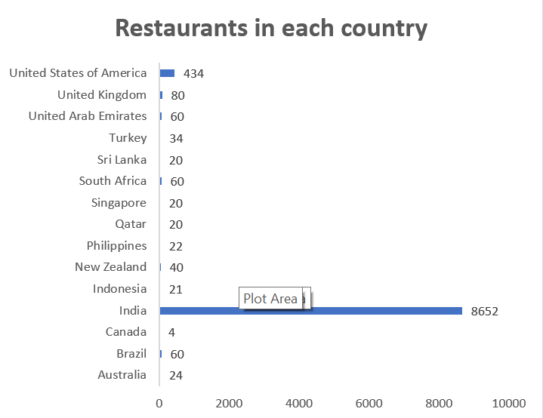
Global Restaurant Distribution
The brand operates 9,551 restaurants across 16 countries.
India (91%) and USA (4.5%) together account for ~95% of total outlets.
Remaining 14 countries collectively contribute just ~5%, highlighting high market concentration.

Slide 6
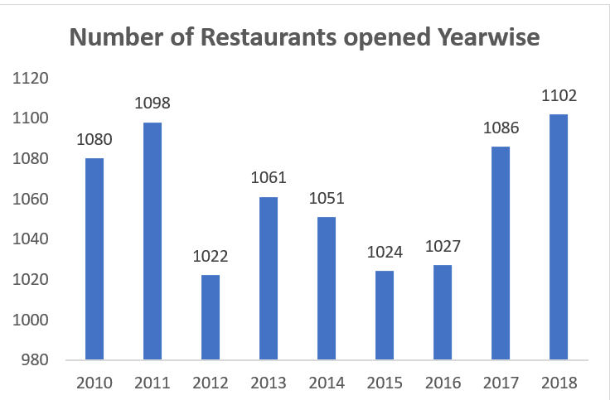
Restaurant Openings: Key Highlights
Stable Range: Openings stayed between 1,022 – 1,102 restaurants annually.
Dip Years: Noticeable declines in 2012 and again during 2014–2016.
Growth Phase: Strong rebound in 2017, leading to the highest peak in 2018 (1,102 openings).
Outlook: Signals renewed industry growth and market expansion after earlier slowdowns.

Slide 7
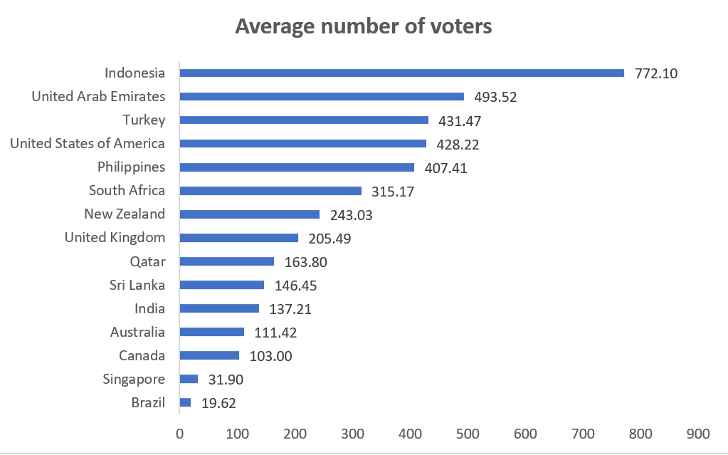
.
Global Voter Participation
Indonesia leads with the highest voter average (772) – far ahead of all other countries.
Strong cluster: UAE, Turkey, USA & Philippines with 400–500 average voters.
Low engagement: Singapore (32) & Brazil (20) show very weak participation, highlighting uneven global traction.

Slide 8
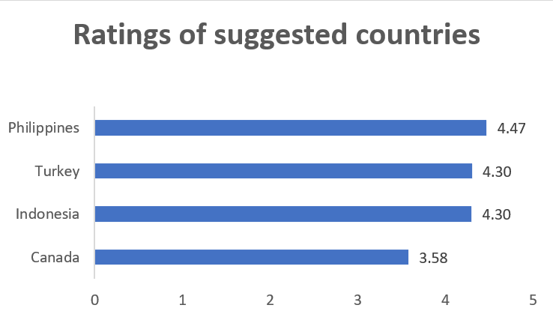
High Ratings, Low Competition: Smart Markets to Enter
Philippines, Turkey & Indonesia shine – high ratings (4.3+), strong customer satisfaction.
Canada: fewer restaurants, less competition – a strategic entry point despite lower rating.
Balanced expansion: tap into quality-driven markets + low-competition advantage.

Slide 9
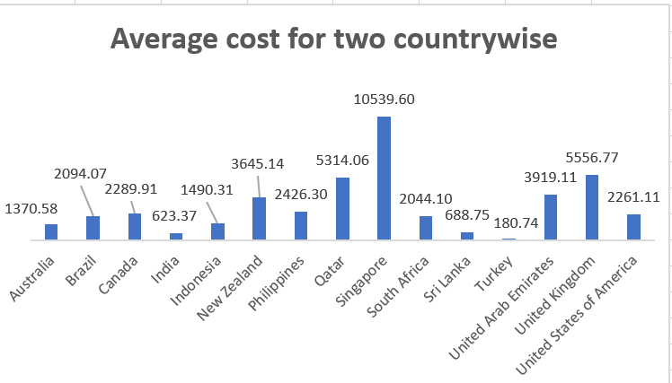
Unequal Food Spending Patterns
Wide disparity in costs: Ranges from Rs180 (Turkey) to Rs10,539 (Singapore), with Singapore as a clear outlier.
High vs Low Cost Nations: UK, Qatar, USA, and Canada are expensive, while Turkey, Sri Lanka, India, and Indonesia are highly affordable.
Pattern: Developed economies trend higher, whereas emerging economies remain more cost-friendly.

Slide 10
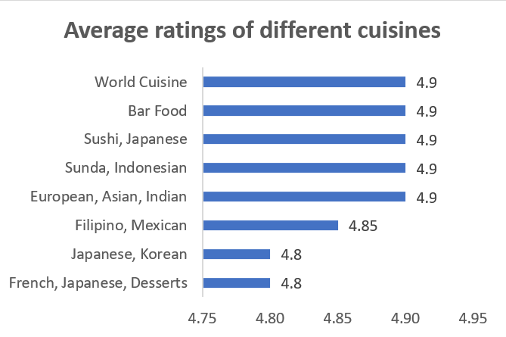
Global Flavors Scoring Near-Perfect Ratings
Highest Rated (4.9/5): World Cuisine, Bar Food, Sushi (Japanese), Sunda (Indonesian), European-Asian-Indian
Strong Ratings: Filipino & Mexican (4.85)
Consistently Liked: Japanese-Korean and French-Japanese-Desserts (4.8)
Narrow Range: Ratings between 4.8 – 4.9, showing overall high customer satisfaction

Slide 11
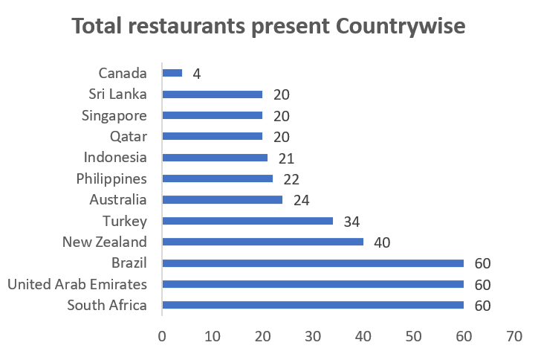
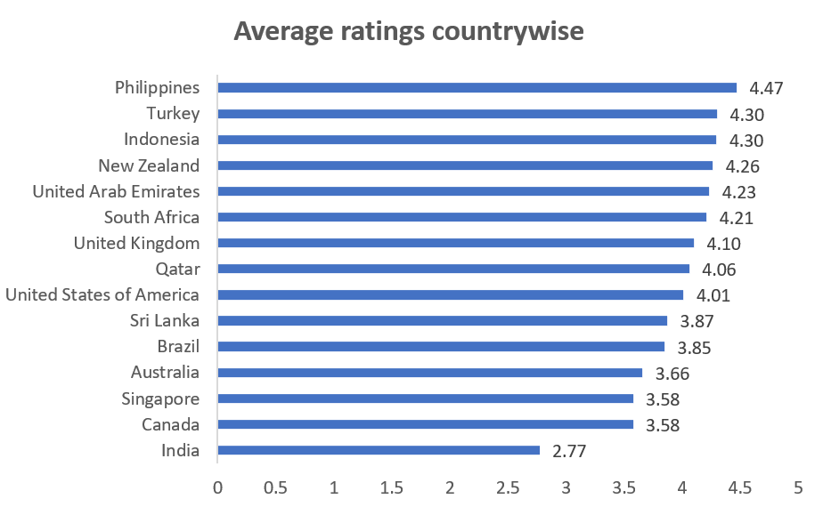
Where to Expand?
Hidden Gems: Philippines, Indonesia & Turkey – high ratings, low competition.
Blue Ocean Market: Canada – just 4 restaurants, huge growth scope.
Smart Expansion Play: Focus on quality-driven & low-competition markets.

Slide 12
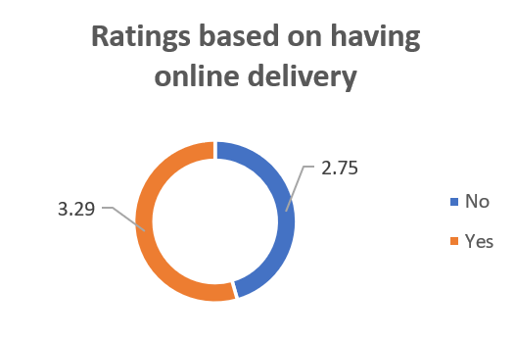
Convenience Wins Customers
Online delivery boosts ratings – 3.29 vs 2.75 without it
Convenience = Higher satisfaction

Slide 13
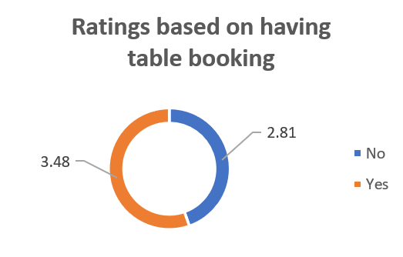
From Walk-in to Winning: Ratings Rise with Booking
Table booking lifts ratings: 3.48 vs 2.81
Convenience = happier customers
Booking option gives restaurants a competitive edge

Slide 14
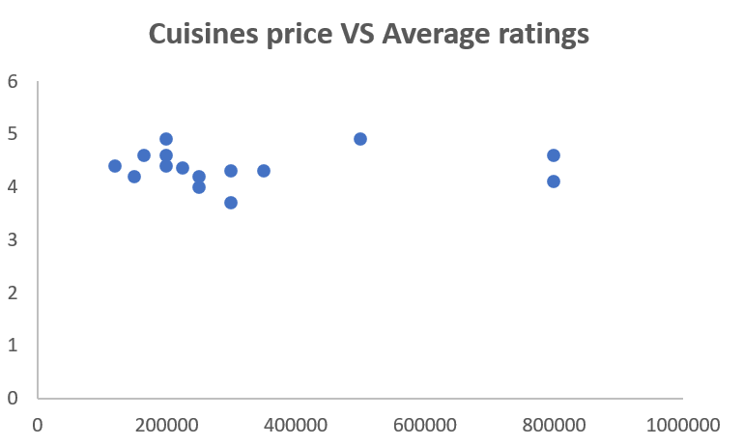
Taste Over Price: Quality Wins Every Time
Price doesn’t define taste — ratings stay high across all price ranges.
Premium cuisines still win love — higher cost, strong ratings.
Quality matters more than price in customer satisfaction.

Slide 15
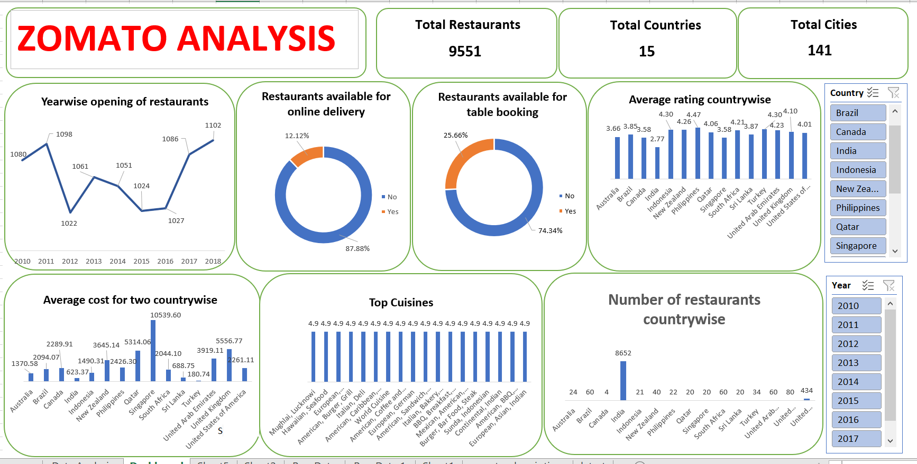

Slide 16
Where Zomato Wins Next
Philippines, Indonesia & Turkey → high ratings, low competition = strong expansion potential.
Canada → untapped “blue ocean” market with minimal presence.
Online delivery & table booking consistently raise customer satisfaction.
Fusion & international cuisines (Sushi, Bar Food, Filipino, Mexican) win global love.
Focus on quality-driven, underpenetrated markets + convenience services = Zomato’s growth path.

Slide 17
CONCLUSION
This analysis highlights that Zomato’s growth lies in diversifying beyond its concentrated markets, focusing on underpenetrated regions, and enhancing customer experience through convenience features. Price is not a barrier to satisfaction—quality and service drive loyalty. By combining market expansion, service innovation, and globally popular cuisines, Zomato can secure sustainable growth and a stronger global presence.

